Slide 1

Computer Graphics and Image Processing
Illumination and Shading II:
Shading Models

Slide 2
Today’s Outline
Rasterisation
Flat Shading
Gouraud Shading
Phong Shading

Slide 3
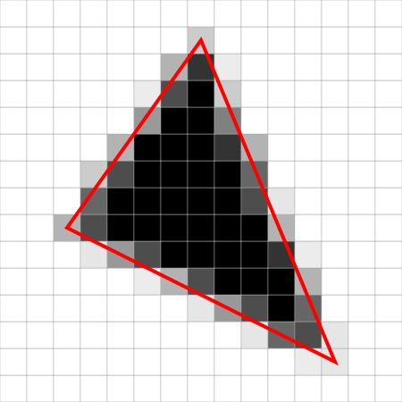
Rasterisation
We define objects as a collection of polygons (shapes)
To draw them, we project them on to a 2D plane
Rasterisation is the process
of turning the projected
shape into pixels.
At a high level, this has two parts:
Determine affected pixels
Determine pixel colour

Slide 4
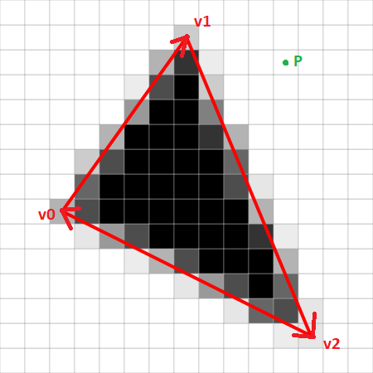
Affected Pixels
Is the pixel in the triangle, or outside it?
We can model the pixel as a point, and the triangle as 3 vectors
If the point is on the same side
of every vector, it’s inside
We use the edge function to
find out the side:
E(P) > 0 if P is on the right
E(P) = 0 if P is on the line
E(P) < 0 if P is on the left
E(P)=(P.x−v0.x)∗(v1.y−v0.y)−(P.y−v0.y)∗(v1.x−v0.x).

Slide 5
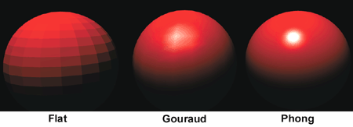
Shading Algorithms

Slide 6
Shading vs Illumination
Illumination tells us how to compute color at a point
We need to decide how we compute color across a surface
Calculate Phong Illumination for every pixel?
Slow!
Instead, calculate at some points, then interpolate

Slide 7
Shading Algorithms
Shading algorithms tell us how we calculate our in-between colours
Three popular options:
Flat shading (fast but poor quality)
Gouraud shading (balance of speed and quality)
Phong shading (slowest but best quality)

Slide 8
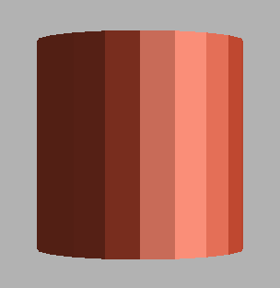
“Curved” Surfaces
In polygon based rendering, everything is made up of flat surfaces (e.g. triangles/quads)
Even things that are supposed to be curved!
More triangles/quads = smoother surface
More triangles/quads = slower
With shading, we can vary
color over a surface to give a
curved appearance
Better shading = smoother surface
A “cylinder”

Slide 9

Flat Shading
Every surface has a face normal
Apply Phong equation once
Shade whole face that colour
Pros: Simple, fast
Cons:
No surface curve
Human eye exaggerates
discontinuities into Mach Bands
Mach Bands
Actual variation
Intensity
Perceived variation
Position

Slide 10
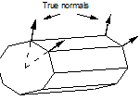
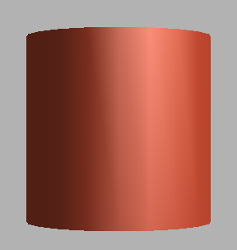
Gouraud Shading
Assign a normal at each vertex
Compute colour at the vertex
Linearly interpolate colour between vertices
Pros:
Still fast
No 0th order color discontinuities
Cons:
Still 1st order discontinuities
(slight Mach bands)
Quadrilateral Invariance problem
Problems with highlights
Intensity
Position

Slide 11
Gouraud Shading: Rasterization
Triangles:
Get colour for each vertex
Interpolate pixel colours along
horizontal scan lines
Quadrilaterals
Problem: not rotationally invariant
Solution: cut each quadrilateral into two triangles
Screen y
Scan line
Screen x
When rotating the quad, the color of the middle pixel changes (first purple, then gray)
Rotate 90°

Slide 12
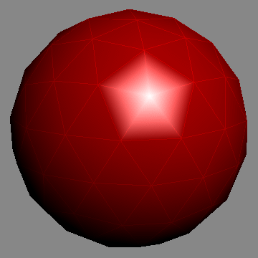
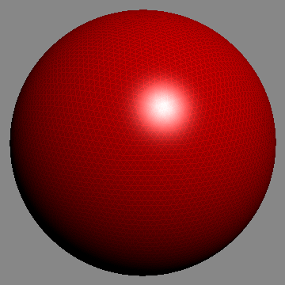
Gouraud Shading: Highlights
Problem: Highlights can only be rendered on a vertex
Highlight might not be sharp (smeared over adjacent faces)
Few vertices might mean no vertex near where the highlight should be
Solution: Use more vertices
Alternative Solution: Use a better shading algorithm
Low number of vertices
High number of vertices
© Zom-B

Slide 13
Phong Shading
Phong Shading ≠ Phong Illumination Model
But it does still use the Phong Illumination model
Every vertex gets a normal
Interpolate the normal across the face
Calculate Phong Illumination at every pixel using the interpolated normal
Normals, interpolated normals

Slide 14
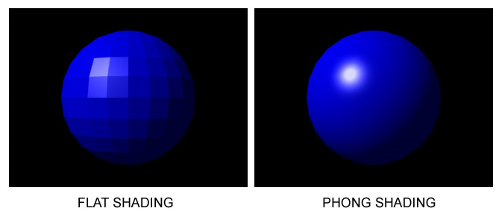
Phong Shading
Pros:
Crisp highlights even with few vertices
Smooth and continuous colour
Cons:
Significantly slower* than Flat or Gouraud shading
*Modern GPUs are so powerful this isn’t normally an issue in practice

Slide 15
Cost of Shading
Flat Shading
1 normal calculation per triangle
1 colour calculation per triangle
No interpolation
Gouraud Shading
1 normal calculation per vertex
1 colour calculation per vertex
1 colour interpolation per pixel
Phong Shading
1 normal calculation per vertex
1 normal interpolation per pixel
1 colour calculation per pixel
1 colour calculation = 1 evaluation of Phong Illumination equation.

Slide 16
Summary
Flat Shading | Gouraud Shading | Phong Shading
Simple and fast Phong equation only once per face | Still fast Phong equation at each vertex No 0th-order color discontinuities | Crisp highlights with few vertices
Mach Bands | Slight mach bands, Color invariance with quadrilaterals, Problems with highlights | Slow Phong calculation for every Pixel

Slide 17

Quiz
What are the disadvantages of Flat shading?
Why can Gouraud shading render a highlight only on a vertex?
What can we observe about the apparent relative intensities of the greys below?

